Slide 1
Down on Mainstreet: The Capital of Community Resilience
Tony Michael, Director and Extension Professor
WVU Extension Service Family & Community Development

Slide 2
Mainstreet as a Metaphor
Defining the economy:
Wall Street or Main Street?
If Wall Street is up, is Main Street down?
What does “Main Street” West Virginia look like?

Slide 3
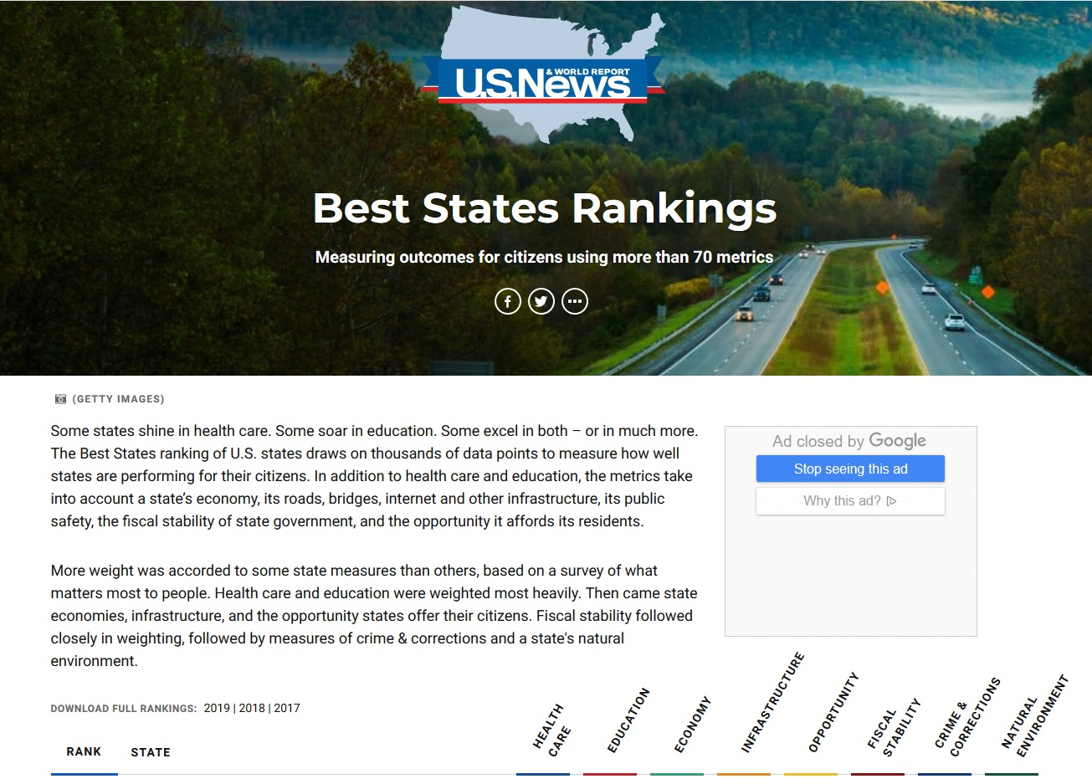

Slide 4
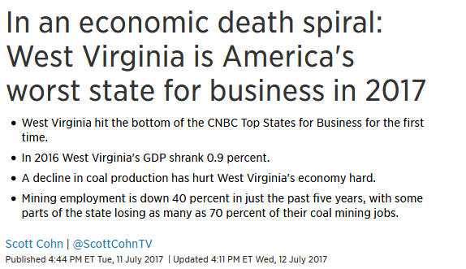
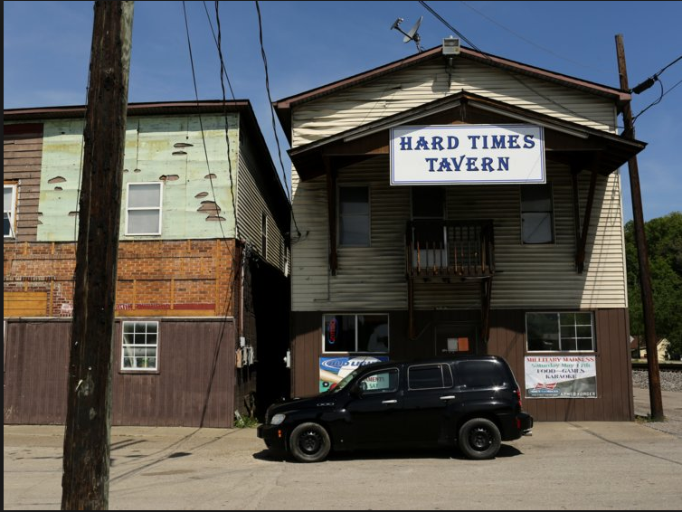
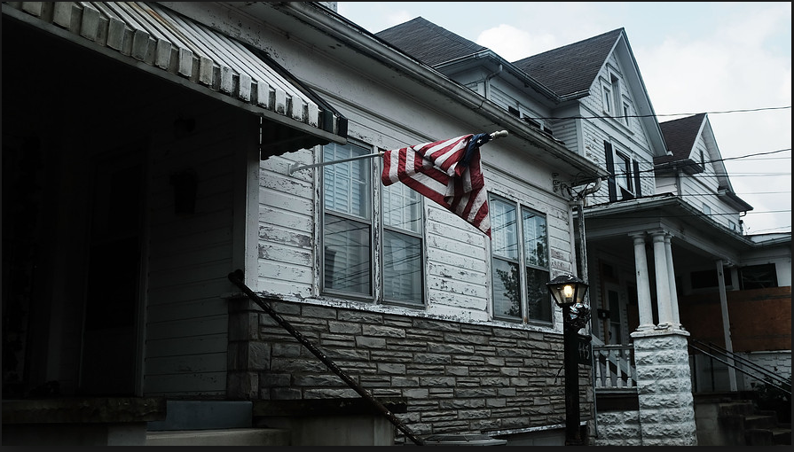
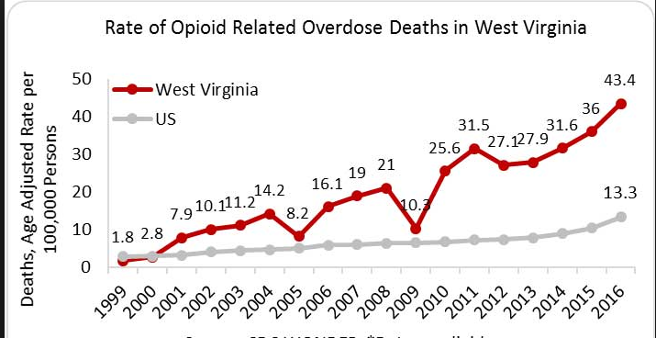
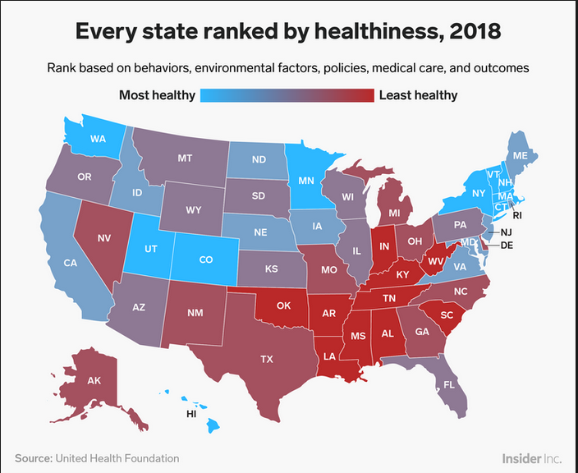
A Needs Driven Dead End
48th in median HHI rankings
49th in PCY rankings
43rd in HH poverty
50th in education attainment (bachelors degree +)
45th share of new entrepreneurs
50th new business startup density
Losing pop. faster than any other state
Extension Assistant Professor Daniel Eades & Extension Professor Michael Dougherty
Adapted from Stout, Eades, and Aurednik, 2018
Notes:
Too often we start with these negative statistics in mind.
Public, private, and non-profit human service systems – supported by university research – translate needs into programs and activities that teach people the nature and extent of their problems and the value of our services in solving their problems
In short, our residents become clients and consumers of our research informed “best practices”
Unfortunately seeing the community as an endless list of needs leads to:
fragmentation of program delivery
The direction of resources to service providers rather than residents
The disparaging of communities to attract resources
And a deepening of the cycle of dependence
The end result is that many of our communities continue to live behind a wall of needs which separates them from “successful” communities

Slide 5
Complex Community Problems
Communities (especially in rural areas) are experiencing significant social, economic, and environmental challenges
To address all factors of quality of life that foster human flourishing and thriving communities, a transdisciplinary approach is needed
To enable translation and shared metrics across disciplines, a common framework is necessary
Daniel Eades, Extension Assistant Professor Eades & Michael Dougherty, Extension Professor
Adapted from Stout, Eades, and Aurednik, 2018
Notes:
In WV these include:
Social issues
Opioid epidemic
Historic pattern of high rates of lifestyle-related illness
Economic issues
Transitioning from a natural resource economy to… ???
Historic pattern of high levels of poverty
Environmental issues
Negative impacts of coal mining and hydraulic fracturing
Record-breaking floods as “the new normal”
Historic resistance to any type of land use controls

Slide 6
What is Community Resilience
Community resilience is a measure of the sustained ability of a community to utilize available resources to respond to, withstand, and recover from adverse situations.
And it should be grounded in resilience science, which tells us how complex systems—like human communities—can adapt and persist through changing circumstances.

Slide 7
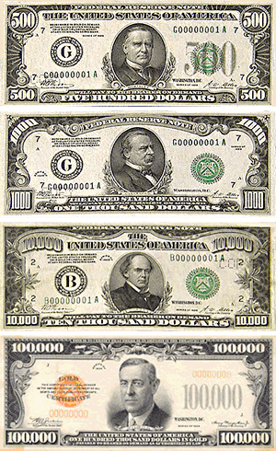
The Capital(s) of Resilience
Community resilience is a measure of the sustained ability of a community to utilize available resources to respond to, withstand, and recover from adverse situations.
In order to be strong and resilient, communities have to develop their community capitals.

Slide 8
Community Capitals
The eight community capitals are:
Cultural
Human
Social
Organizational
Political
Financial
Natural
Built
The Community capitals Framework was created by Cornelia and Jan Flora. See: Flora, C.B. and J.L. Flora. 2013. Rural Communities: Legacy and Change, 4th Edition. Boulder, CO: Westview Press

Slide 9
Social Capitals of Community Resilience
Cultural Capital
History, traditions, belief systems, language, creativity, and outlooks that enable both a sense of identity and capacity for change
Human Capital
Health, skills, knowledge, abilities, and optimistic dispositions
Social Capital
Trusting, respectful, and caring relationships within groups and across difference

Slide 10
Economic
Capitals of Community Resilience
Organizational Capital
Effective structure, policies, plans, and track record of existing groups and anchor institutions providing goods and services
Political Capital
Responsive political leaders, active civic engagement, and the ability to make or influence public policy at local, county, state, and federal levels of government
Financial Capital
Sufficient basic income, the ability to build wealth, access to investment, lending, and philanthropy, and local reinvestment

Slide 11
Environmental
Capitals of Community Resilience
Natural Capital
Geography, climate, land and natural resources, natural beauty and recreation areas, and environmental quality and safety
Built Capital
Trails, sidewalks, lights, roads, bridges, buildings, utility systems, communications technologies, and public facilities and gathering places

Slide 12
WVUES and Community Capital
The Community Capitals Framework provides a holistic organizing structure and basic definitions, but no clear direction in regard to indicators and benchmarks
Effective assessment, planning, technical assistance and evaluation requires this type of data

Slide 13
Data Driven Capital
Drawing from widely available population statistics, community data and analytics are abundant
Community Indicators Consortium
http://www.communityindicators.net/home
Community Commons
https://www.communitycommons.org/
Thriving Cities
http://explore.thrivingcities.com/endowments

Slide 14
Data Driven Capital What makes sense?
A place-based approach that can accommodate primary data collection through qualitative methods and attend to history and culture
A participatory democratic approach to knowledge production that can attend to politics and enable collaboration
Which particular indicators to choose (i.e., social science) becomes less important than shared agreement among stakeholders to use them to guide decision making and action

Slide 15
Community Capitals
The eight community capitals are:
Cultural
Human
Social
Organizational
Political
Financial
Natural
Built
The Community capitals Framework was created by Cornelia and Jan Flora. See: Flora, C.B. and J.L. Flora. 2013. Rural Communities: Legacy and Change, 4th Edition. Boulder, CO: Westview Press

Slide 16
Community Capitals Dynamics
“Spiraling” theory suggests a developmental path among community capitals
Building social factors…
enables development of economic assets…
which support environmental improvements…
which foster healthier social factors…
Daniel Eades, Extension Assistant Professor Eades & Michael Dougherty, Extension Professor
Adapted from Stout, Eades, and Aurednik, 2018

Slide 17
Notes:
The Community Capitals Framework provides the common framework for discussing, measuring, and sharing impacts
CED actors work within an overall change process, each contributing various capacity-building activities designed to improve specific community assets. These activities produce outcomes that enhance community capacity for community and economic development; over time, collective impact to community quality of life can be measured.
CD actors
conduct activities – we raise awareness about issues, organize and mobilize community recourses, plan, “do” and evaluate
These activities enhance, leverage, or generate community capital
These are the asset base of the community

Slide 18
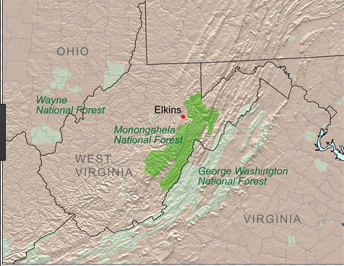
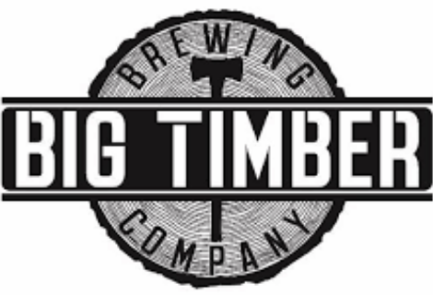
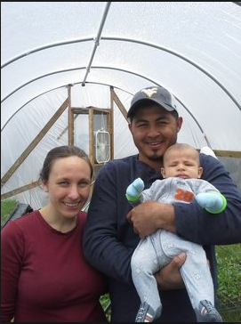
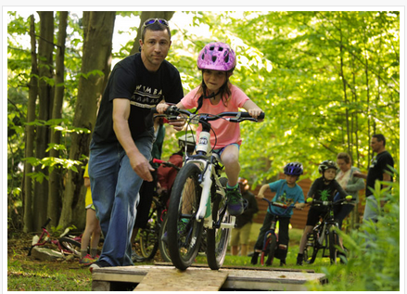
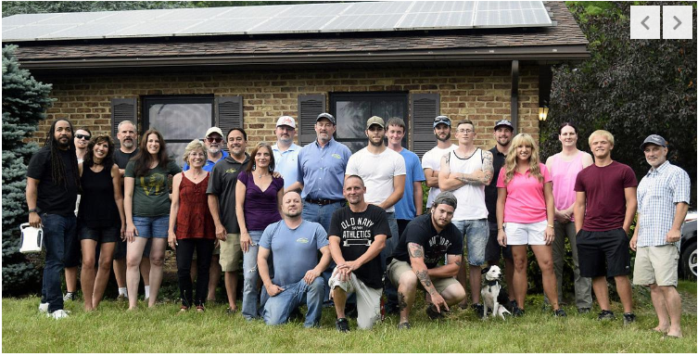
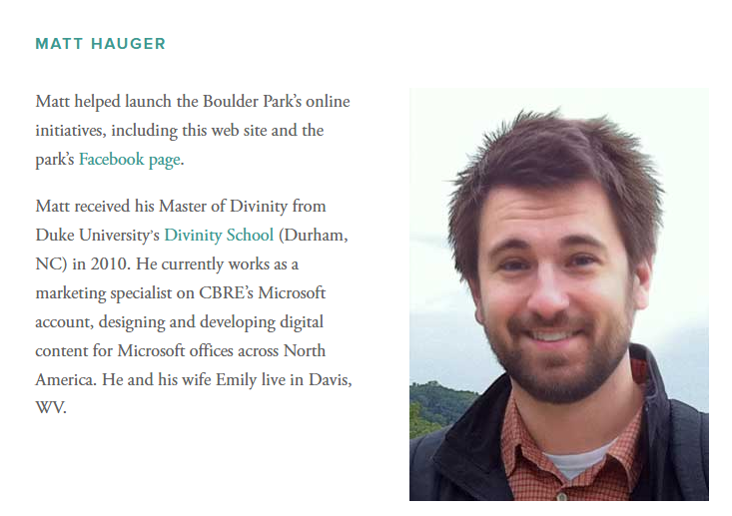
Community Capitals – Mon Forest
“My husband and I have always come here for recreation. Why not invest in a place you love.”
– Tucker Co. retail store owner
Notes:
The alternative path – and the path that I think is most in line with Extension’s mission – is to develop programs and activities based on the capacities, skills, interests, and assets of the communities in which we work
The hard truth is that top-down and outside-in strategies aren’t the most effective:
Outside funding for programs is becoming increasingly scarce
The odds of attracting large-scale, job providing industries are long
Evidence shows that significant human and community development occurs with people are committed to investing themselves and their resources in the effort

Slide 19
Community Capitals – Marlinton
Peter Butler, Associate Professor and Extension Specialist

Slide 20
Community Capitals – Marlinton
Peter Butler, Associate Professor and Extension Specialist

Slide 21
WVUES and the Community Capitals of Resilience
Which community capitals do you focus on in your work?
How does data guide your programing currently?
What indicators and metrics do you use to assess capacity in these capitals?
Let’s share… Are there commonalities?

Slide 22
Community Capital Framework for Funding
Funders in Central Appalachia want a coherent approach to developing and analyzing shared metrics
The Appalachian Funders Network
“the more relationships, common analysis, and vision we have, the more we can align our strategies to make lasting impact on the root cause challenges holding back the region from greater prosperity”
This has become particularly relevant in light of POWER grants to coal-impacted communities
Daniel Eades, Extension Assistant Professor Eades & Michael Dougherty, Extension Professor
Adapted from Stout, Eades, and Aurednik, 2018

Slide 23
Main Street Economics and Community Resilience
We are working across the University to support significant change in our state.
The community capital framework and community resilience are intricately linked, and the University can support community efforts to develop their capitals and be resilient.

Slide 24
In an announcement last week:
The Center for Resilient Communities in the Eberly College at WVU is pleased to invite you to attend a public lecture entitled Redrawing Economies: Making other Worlds Possible in Uncertain Times by Dr. Stephen Healy, Senior Research Fellow at the Institute for Culture and Society at Western Sydney University, Australia on Tuesday, October 8, 2019. In his talk Stephen dismantles the idea that the economy is separate from us and best comprehended by experts. Rather he argues that the economy is the outcome of the decisions and efforts we make every day.

