Slide 1
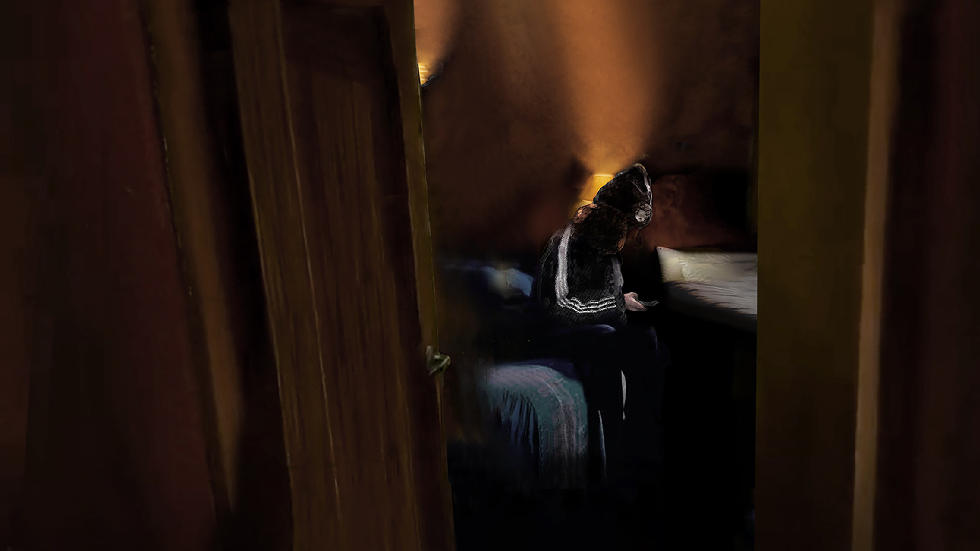
Hiding in Plain Sight Polarization and Extremism Online Impacting Youth in Appalachia

Slide 4
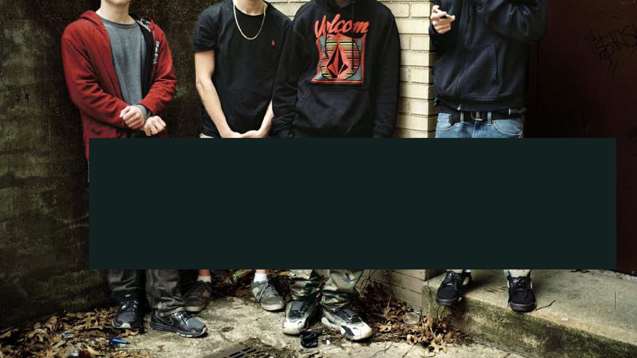

Slide 7
Trolls and Nonstate Bad Actors
Non- organized Actors
Organized Extremist Groups
State Actors
"Arms Dealers"
Algorithms
Motivated by Mischief, other reasons
Posts inflammatory and outrageous content for the LOLZ, other attention- seeking behaviors. Can still be harmful, abusive and dangerous
Disinformation
Campaigns
Coordinated actions by other countries designed to amplify polarization, seed social dysfunction, mistrust, and to disseminate destabilizing propaganda.
Unaffiliated w/ formal groups
Individuals who engage w/ and distribute extremist or adjacent content but are not formally or knowingly associated with organized groups.
Recognized hate groups or terrorist organizations
Includes unknown homegrown splinter cells, diffuse regional/ international networks.
Financial Motivations
Not ideologically motivated but who create, distribute and amplify extremist and extremist adjacent content for profit.
Systematic Amplifcation
Complex, proprietary machine learning software that platofrms apply to systematically personalize content with high monetization/ engagement potential.

Slide 8
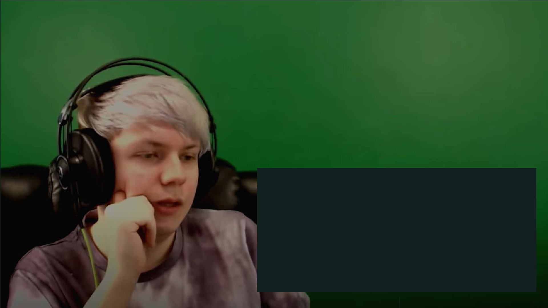
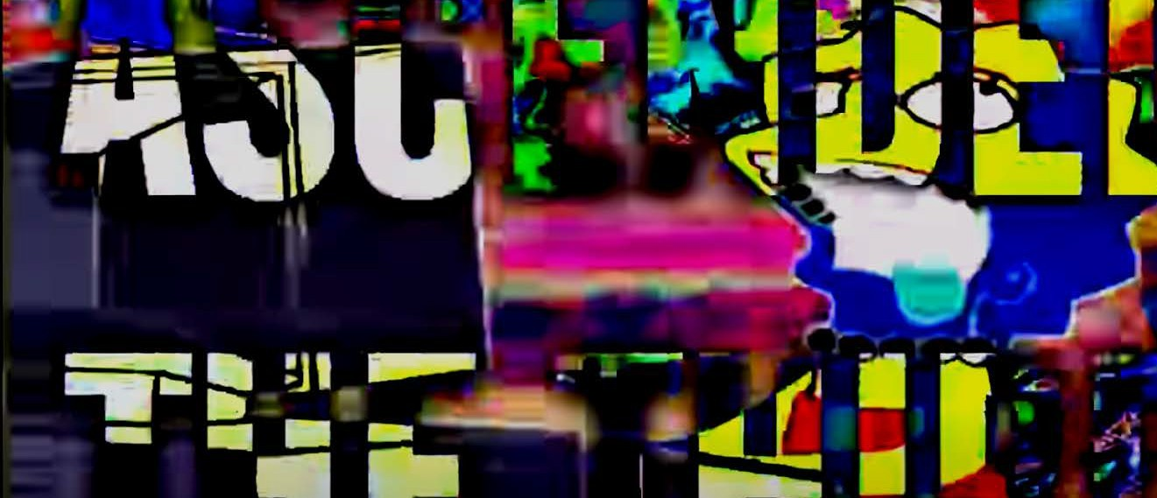

Slide 9
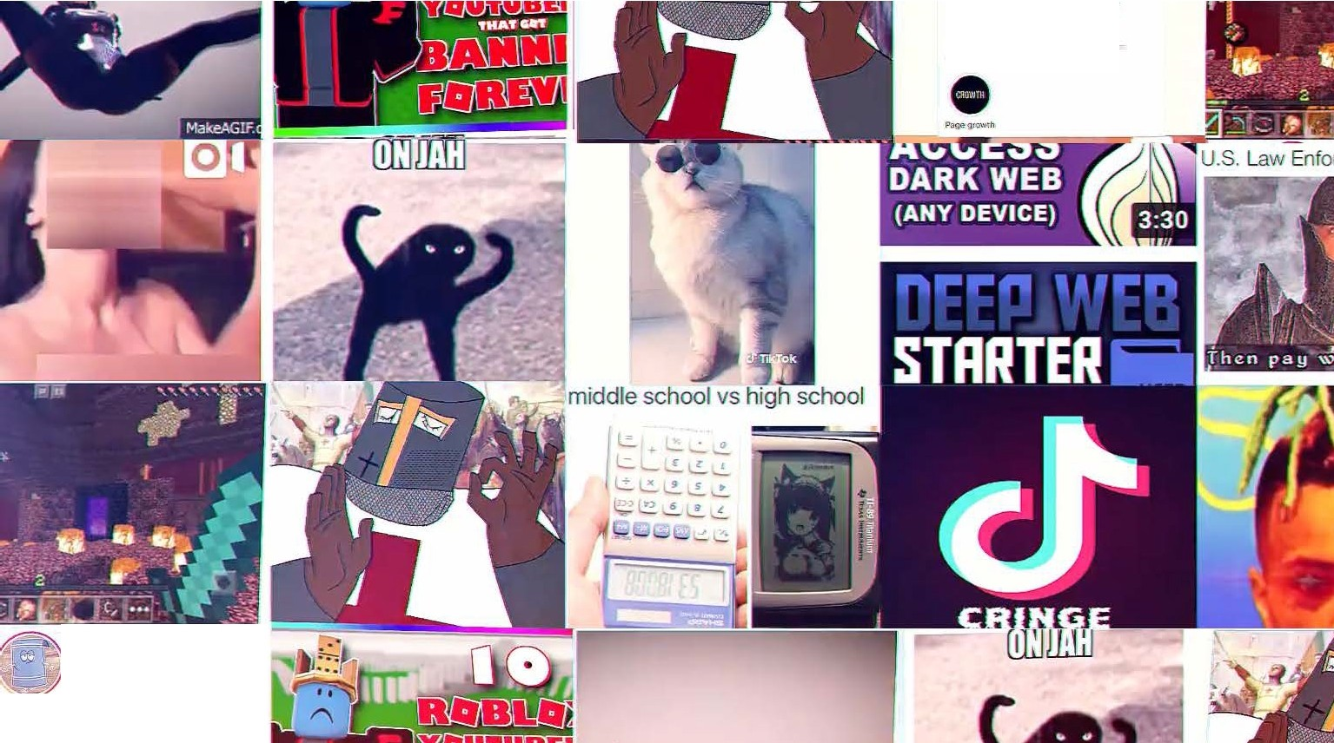
dm @leewawpromotions,fe.rtpremes/ business
ba.ckop page: @toweltes2
,771
;;:;13
287K 284
.I
I' • ,f
'
.1!tY."'
Message
,:.....- ...
Memes
·011ow @double.edge-to be accepted
:Jm @Jeewayyp.romo.tions tor promo.s/

Slide 10
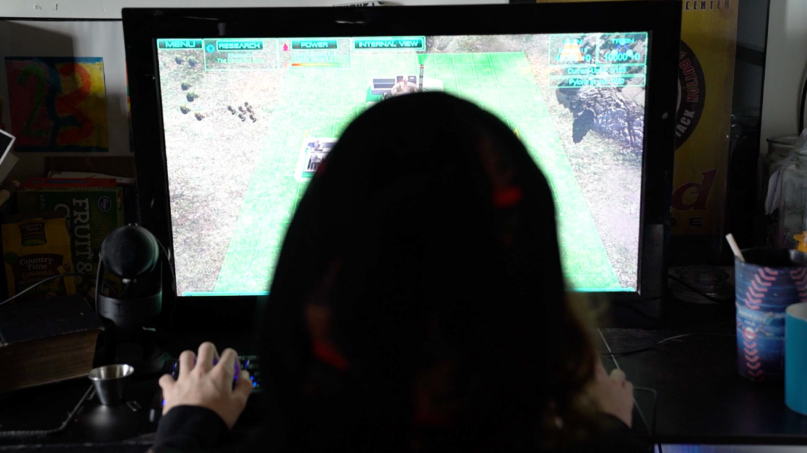

Slide 11
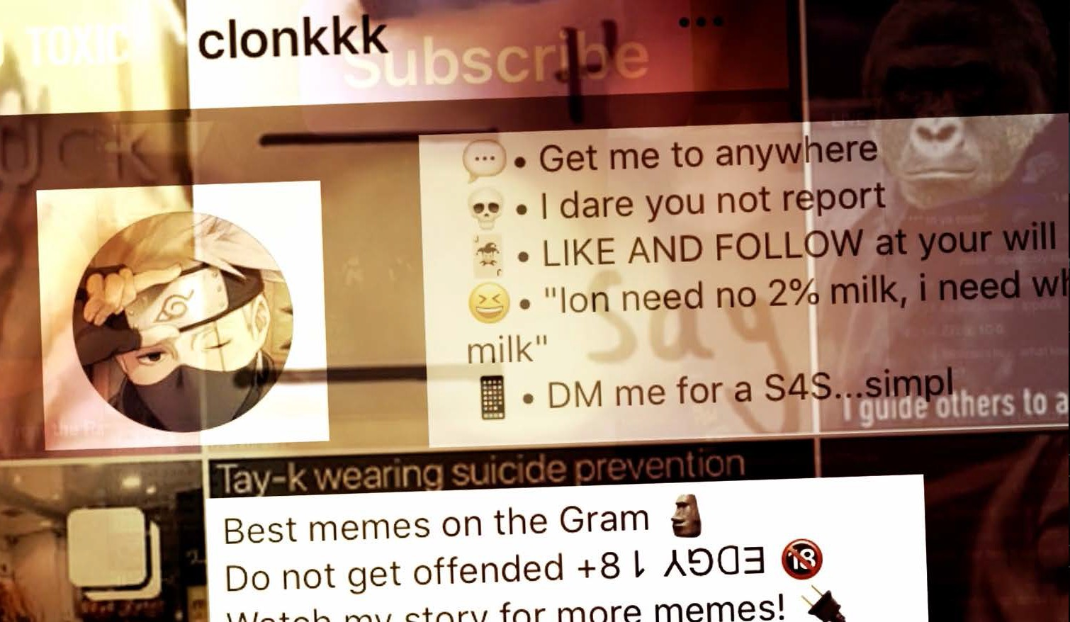

Slide 12
myth of the
lone wolf

Slide 14
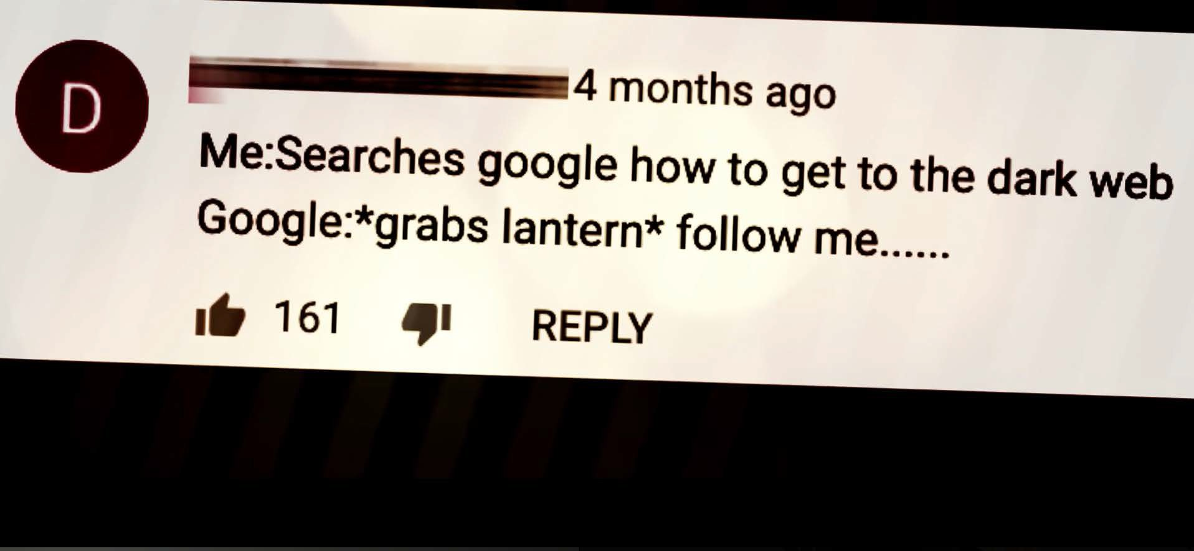

Slide 15
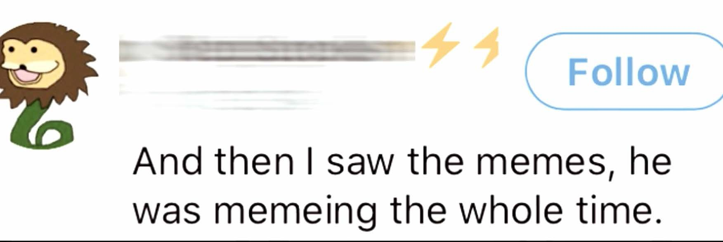

Slide 16
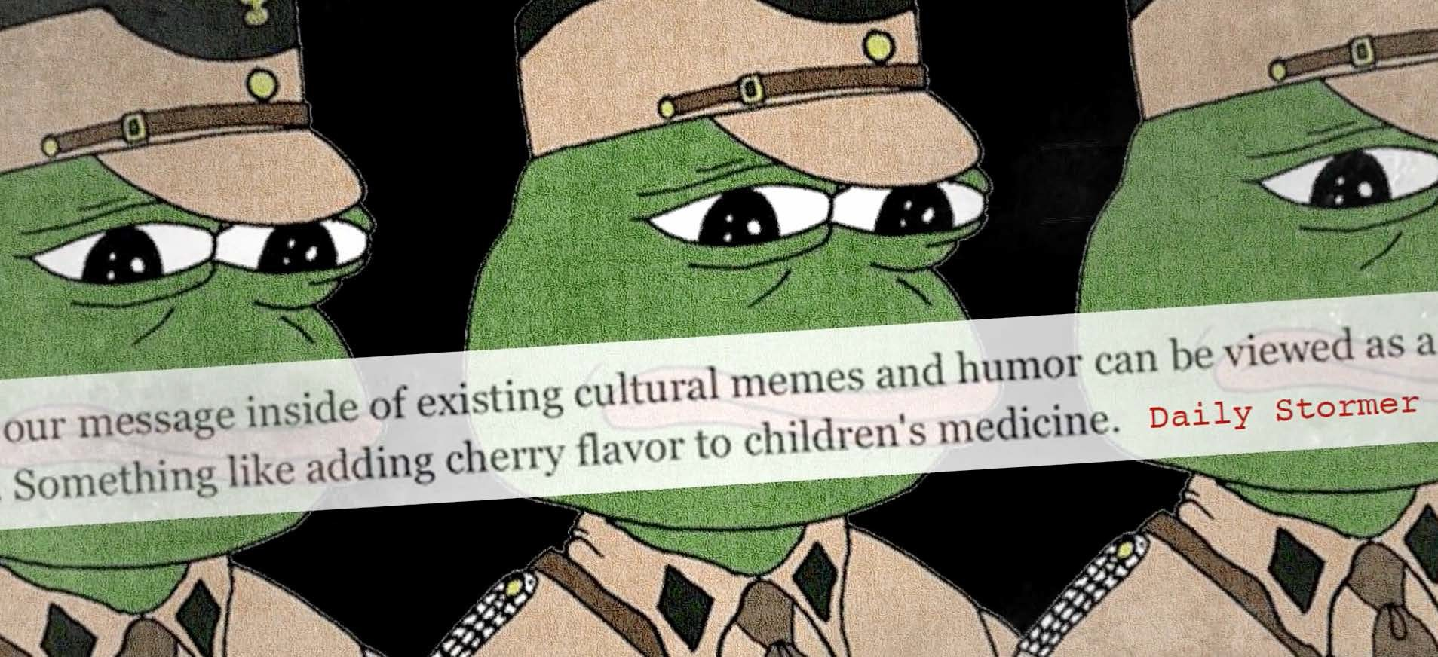

Slide 18
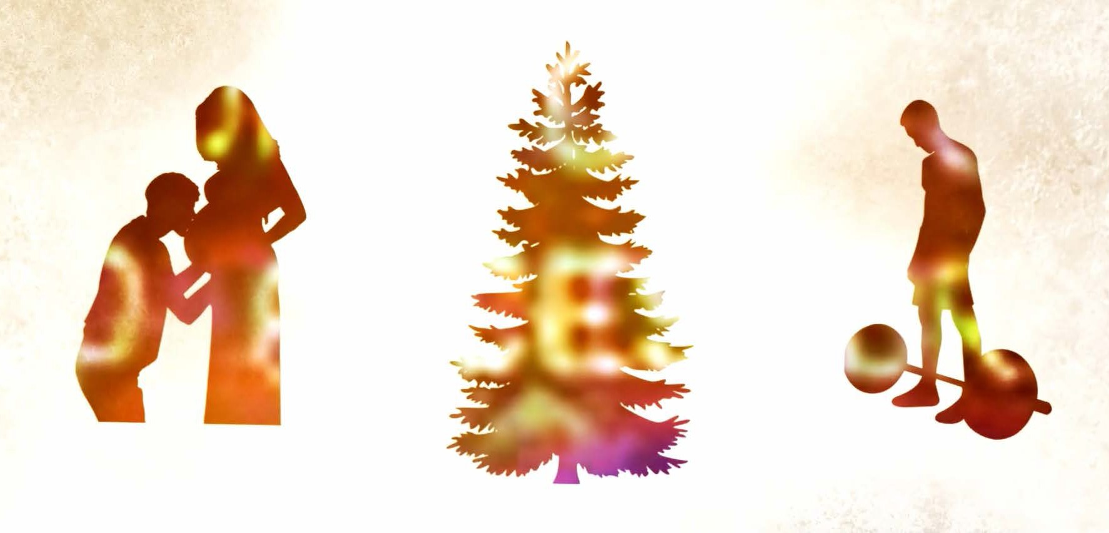

Slide 19
The Instagram Experiment

Slide 20
"Children are like sunflowers. They will turn to whatever light is shining on them."

Slide 21
Thank you. Dana Coester dana.coester@mail.wvu.edu

