Slide 1
Academic Media Day 2019
Through a Different Lens: The Arts as a Key to Population Growth and Retention

Slide 2
Keith Jackson, Philip J. Faini/Falbo Family Dean. College of Creative Arts

Slide 3
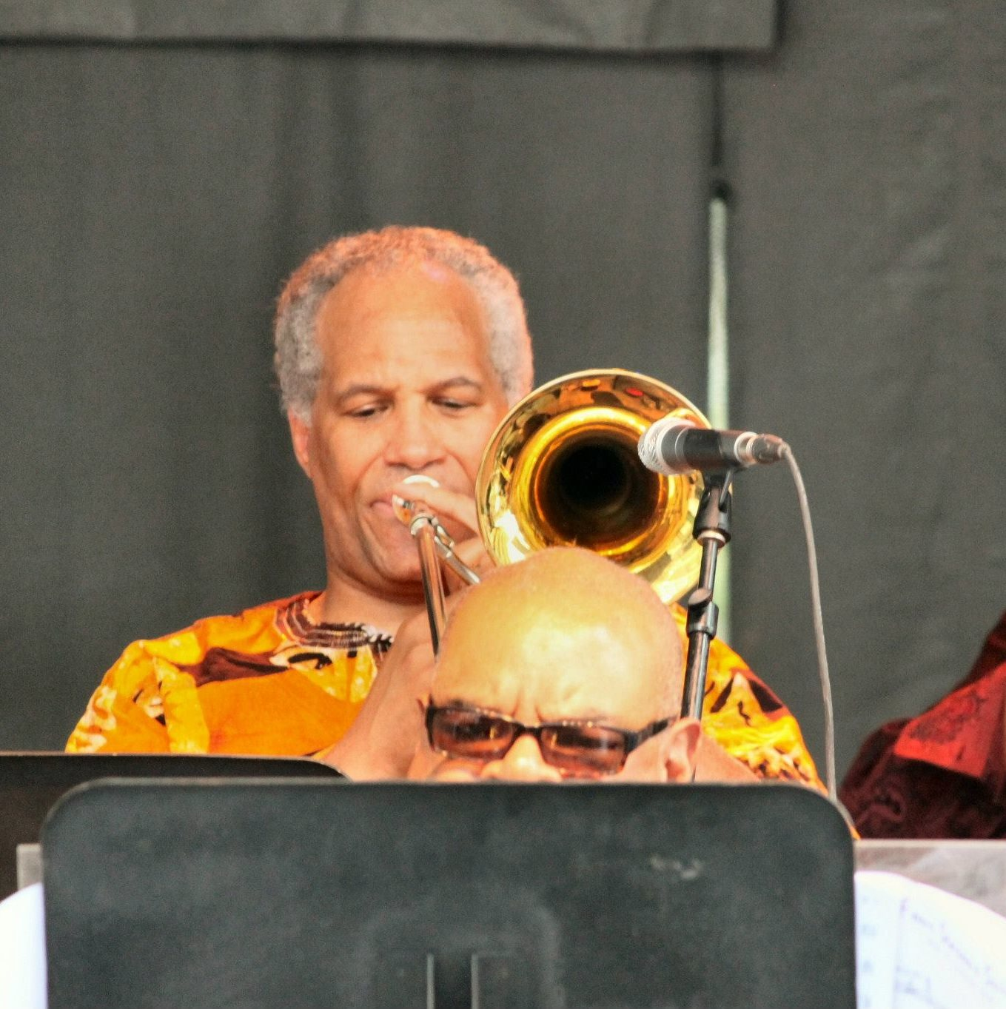
A Little About Me
I am a Professional Trombonist in Classical and Jazz Styles

Slide 4
A Little About Me

Slide 5
A Little About Me

Slide 6
A Little About Me

Slide 7
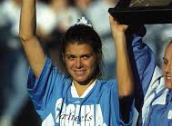
A Little About Me
First Full-Time Professional Position was at the University of North Carolina teaching:
Athletic Bands
Applied Low Brass
Jazz
Chamber Music
Music Education Classes
Bottle Washing!!

Slide 8
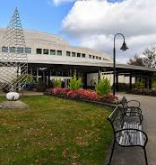
And Since 1995
Came to WVU as the Trombone Professor in 1995
Became Director of the School of Music in 2008
Became Dean of the College of Creative Arts in 2017

Slide 9
Some things about Artists!

Slide 10
Some things about Artists!
Students in the Arts are able to accept and give criticism.

Slide 11
Some things about Artists!
Students in the Arts are able to accept and give criticism.
Successful Artists are Adaptable

Slide 12
Some things about Artists!
Students in the Arts are able to accept and give criticism.
Successful Artists are Adaptable
Successful Artists have entrepreneurial qualities (whether they know it or not)

Slide 13
Some things about Artists!
Students in the Arts are able to accept and give criticism
Successful Artists are Adaptable
Successful Artists have entrepreneurial qualities (whether they know it or not)
Successful Artists have some fundamental awareness of business realities

Slide 14
Some things about Artists!
Students in the Arts are able to accept and give criticism
Successful Artists are Adaptable
Successful Artists have entrepreneurial qualities (whether they know it or not)
Successful Artists have some fundamental awareness of business realities
Artists understand joy vs fun and Successful Artists understand when there is a client

Slide 15
Some things about Artists!
Students in the Arts are able to accept and give criticism
Successful Artists are Adaptable
Successful Artists have entrepreneurial qualities (whether they know it or not)
Successful Artists have some fundamental awareness of business realities
Artists understand joy vs fun and Successful Artists understand when there is a client
Performing artists work in teams and understand roles and community

Slide 16
Some things about Artists!
Students in the Arts are able to accept and give criticism
Successful Artists are Adaptable
Successful Artists have entrepreneurial qualities (whether they know it or not)
Successful Artists have some fundamental awareness of business realities
Artists understand joy vs fun and Successful Artists understand when there is a client
Performing artists work in teams and understand roles and community
Most Artists understand the value of time and tend to be blunt- not universal)

Slide 17
Artists Understand the Gig Economy
After all we invented the word “gig” in the roaring 20’s!

Slide 18
Some Clear Starting Points
Population and “Type of Population”
Taxbase!!!
Jobs are critical but ………….

Slide 19
A Rarely Discussed Opinion
Rural and Urban Approaches are Similar

Slide 20
Great Sources

Slide 21
Great Sources
Rural Prosperity through the Arts & Creative Sector -NGA

Slide 22
Great Sources
Rural Prosperity through the Arts & Creative Sector –NGA
SMU Data Arts

Slide 23
Great Sources
Rural Prosperity through the Arts & Creative Sector –NGA
SMU Data Arts
City Lab

Slide 24
Great Sources
Rural Prosperity through the Arts & Creative Sector –NGA
SMU Data Arts
City Lab
Americans For the Arts

Slide 25
Great Sources
Rural Prosperity through the Arts & Creative Sector –NGA
SMU Data Arts
City Lab
Americans For the Arts
Bureau of Economic Analysis

Slide 26
Great Sources
Rural Prosperity through the Arts & Creative Sector –NGA
SMU Data Arts
City Lab
Americans For the Arts
Bureau of Economic Analysis
Lots of Canadian Sources also exist

Slide 27
How Artists and WVU Can Use the Arts to Retain and Gain Population

Slide 28
How Artists and WVU Can Use the Arts to Retain and Gain Population
Create Replicable Models Appropriate for Different Regions

Slide 29
How Artists and WVU Can Use the Arts to Retain and Gain Population
Create Replicable Models Appropriate for Different Regions
Be Active in the Educational Benefit of the Arts, (in and out of school)

Slide 30
How Artists and WVU Can Use the Arts to Retain and Gain Population
Create Replicable Models Appropriate for Different Regions
Be Active in the Educational Benefit of the Arts, (in and out of school)
Stress the Importance of Arts for Building a Sense of Community

Slide 31
How Artists and WVU Can Use the Arts to Retain and Gain Population
Create Replicable Models Appropriate for Different Regions
Be Active in the Educational Benefit of the Arts, (in and out of school)
Stress the Importance of Arts for Building a Sense of Community
Realize the Arts are Critical for a Sense of Civic Identity

Slide 32
How Artists and WVU Can Use the Arts to Retain and Gain Population
Create Replicable Models Appropriate for Different Regions
Be Active in the Educational Benefit of the Arts, (in and out of school)
Stress the Importance of Arts for Building a Sense of Community
Realize the Arts are Critical for a Sense of Civic Identity
Artists Need to Accept Our Role as a Type of Entertainment and Escape

Slide 33
How Artists and WVU Can Use the Arts to Retain and Gain Population
Create Replicable Models Appropriate for Different Regions
Be Active in the Educational Benefit of the Arts, (in and out of school)
Stress the Importance of Arts for Building a Sense of Community
Realize the Arts are Critical for a Sense of Civic Identity
Artists Need to Accept Our Role as a Type of Entertainment and Escape
Artists Must Reach Out to All Generations, (not just those with disposable income)

Slide 34
Pockets with Enormous Potential
Thomas
Shepherdstown
Elkins
Morgantown
Lewisburg
Charleston

Slide 35
Questions

