Slide 1

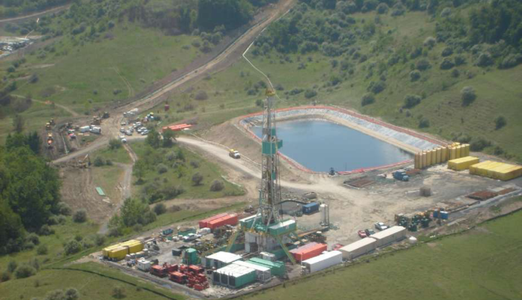
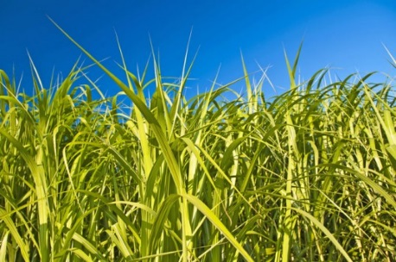
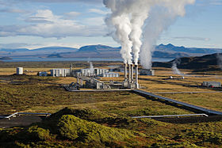
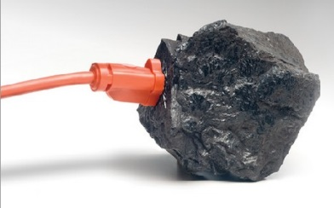
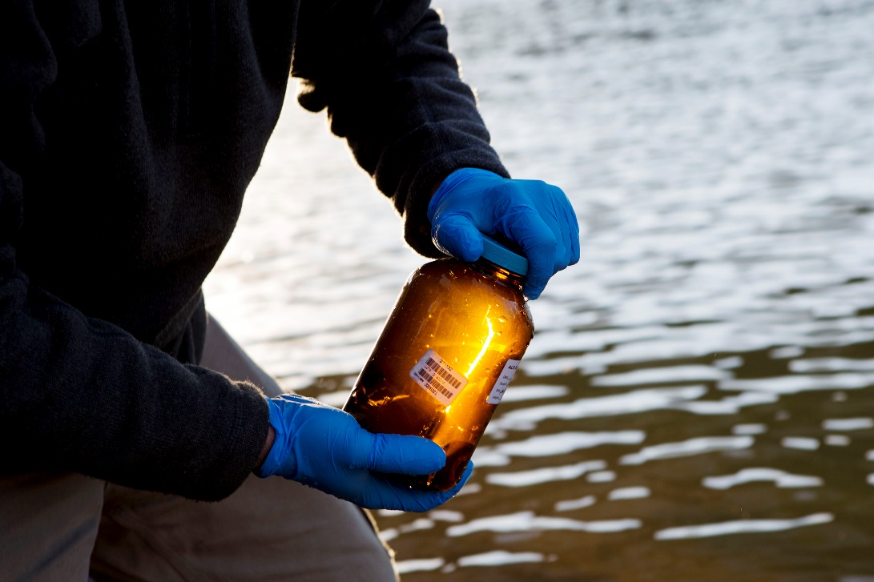
What MSEEL Tells us about shale gas water and waste
Paul Ziemkiewicz, PhD, Director
West Virginia Water Research Institute
West Virginia University
Academic Media Day
Morgantown WV
11 Oct 16

Slide 2
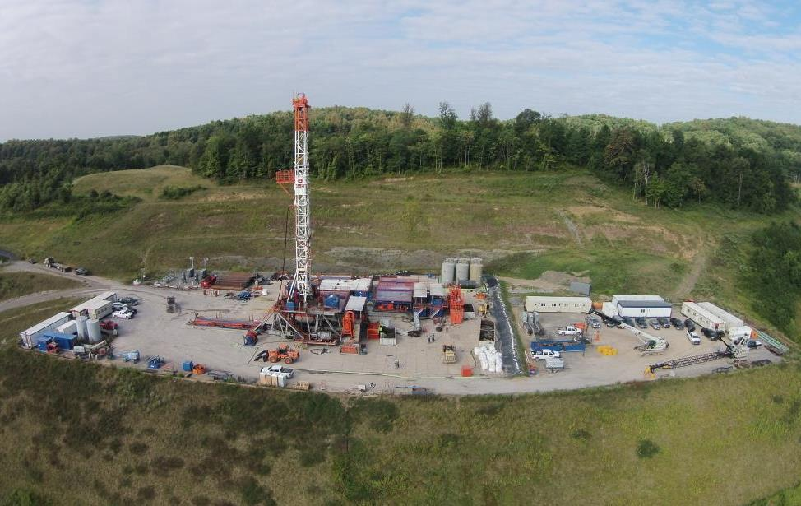





Marcellus Shale Energy and Environment Laboratory
MSEEL
Notes:
TITLE: The Marcellus Shale Energy and Environment Laboratory (MSEEL)
The Marcellus Shale Energy and Environment Laboratory (MSEEL) consists of a multidisciplinary and multi-institutional team undertaking integrated geoscience, engineering and social science research in cooperation in cooperation with the operator, Northeast Natural Energy, numerous industrial partners and the National Energy Technology Laboratory of the US Department of Energy. MSEEL consists of two legacy horizontal production wells, two new instrumented horizontal production wells, a vertical pilot bore-hole, a microseismic observation well and surface geophysical and environmental monitoring stations. Production from the new horizontal well began in December 2015. The goal is to develop and validate new knowledge and technology that can improve recovery efficiency and minimize environmental impacts of unconventional resource development. The MSEEL approach is data driven with a platform to store, manage, publish and share very large and diverse (multiple terabyte) datasets among researchers. MSEEL integrates drilling and fracture stimulation operations, geophysical observations, fiber-optic monitoring of high-resolution temporal and spatial flow of injected and produced fluids, and produced gases, mechanical properties logs, microseismic and core data to better to characterize subsurface rock properties, faults and fracture systems. Models at multiple scales are being developed to identify best practices for field implementation, and assess potential methods that could enhance shale gas recovery through experimental and numerical studies integrated with the detailed results of the production wells at the MSEEL site.
We provide several examples that illustrate technologies and approaches that are being developed to store, query, and display and analyze large and diverse data sources and new data types derived from surface and subsurface to design innovative stage spacing and cluster density practices that can be used to optimize recovery efficiency.

Slide 3
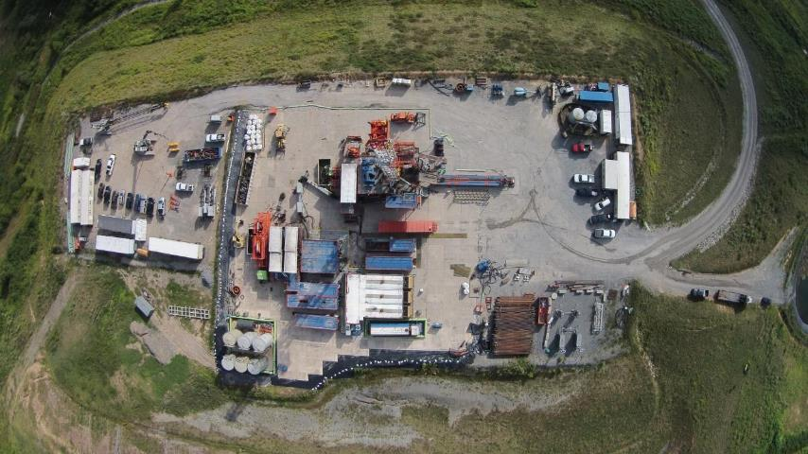
MSEEL
Drilling MIP 3H and 5H

Slide 4
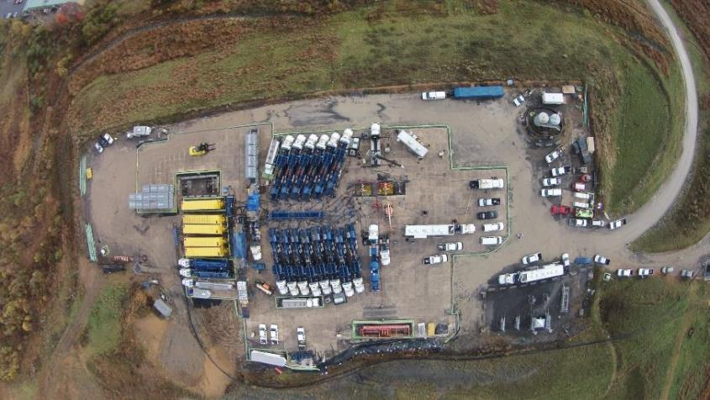
MSEEL
Completion MIP 3H and 5H

Slide 5
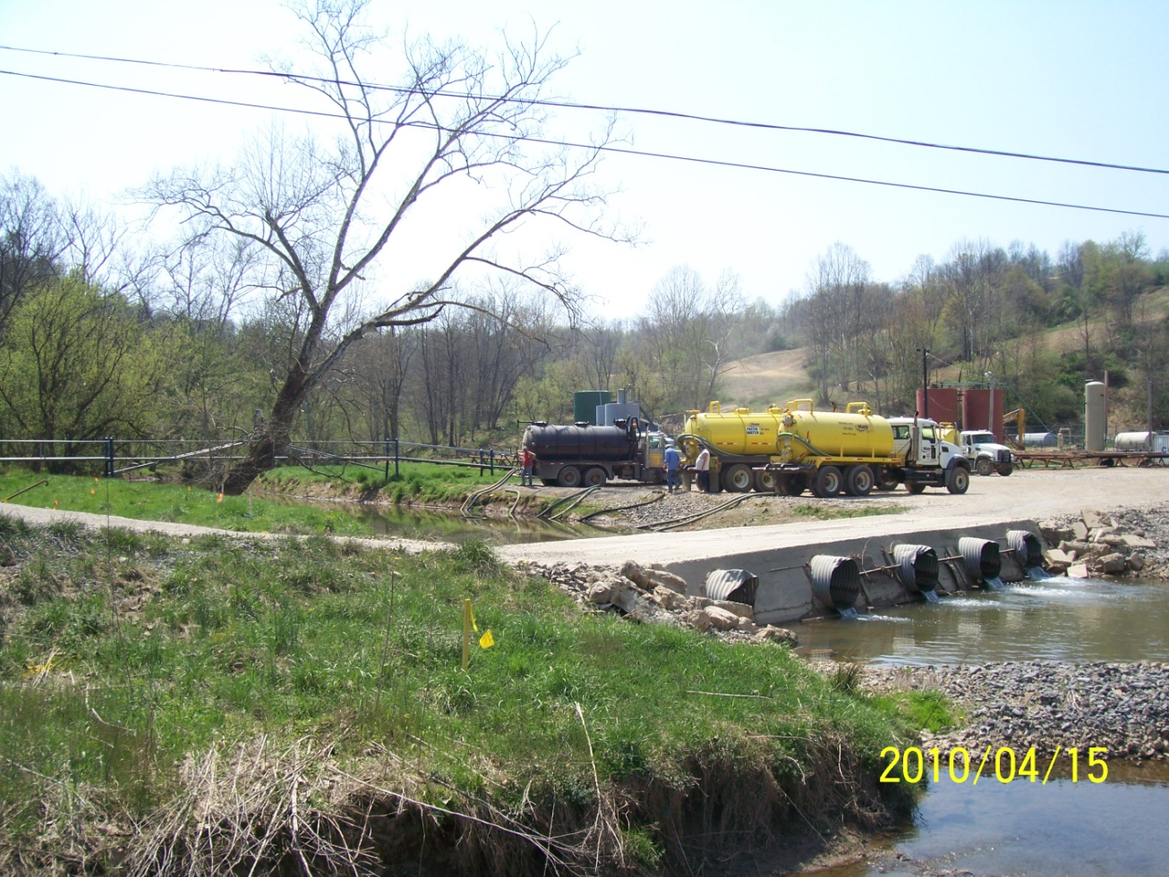
Water and solid waste studies: Characterization and management
Water
Solid wastes
Hydrofrac fluids
Makeup water
Flowback
Produced water
Drill cuttings
Mud

Slide 6
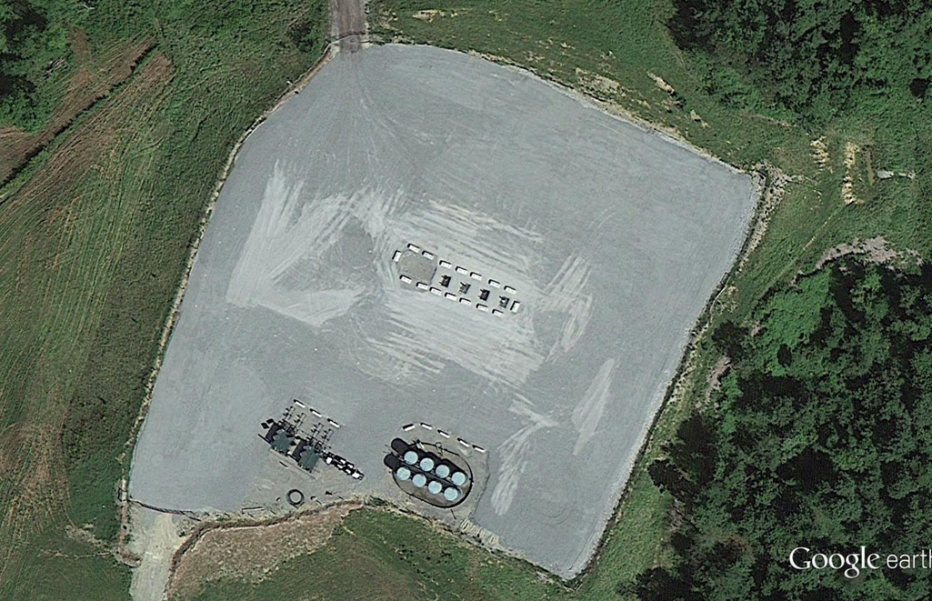
Producing Marcellus well pad: 4 wells
2 hectares total
access/service road
out slopes
1.2 hectares pad
well heads
separators
condensate tanks

Slide 7
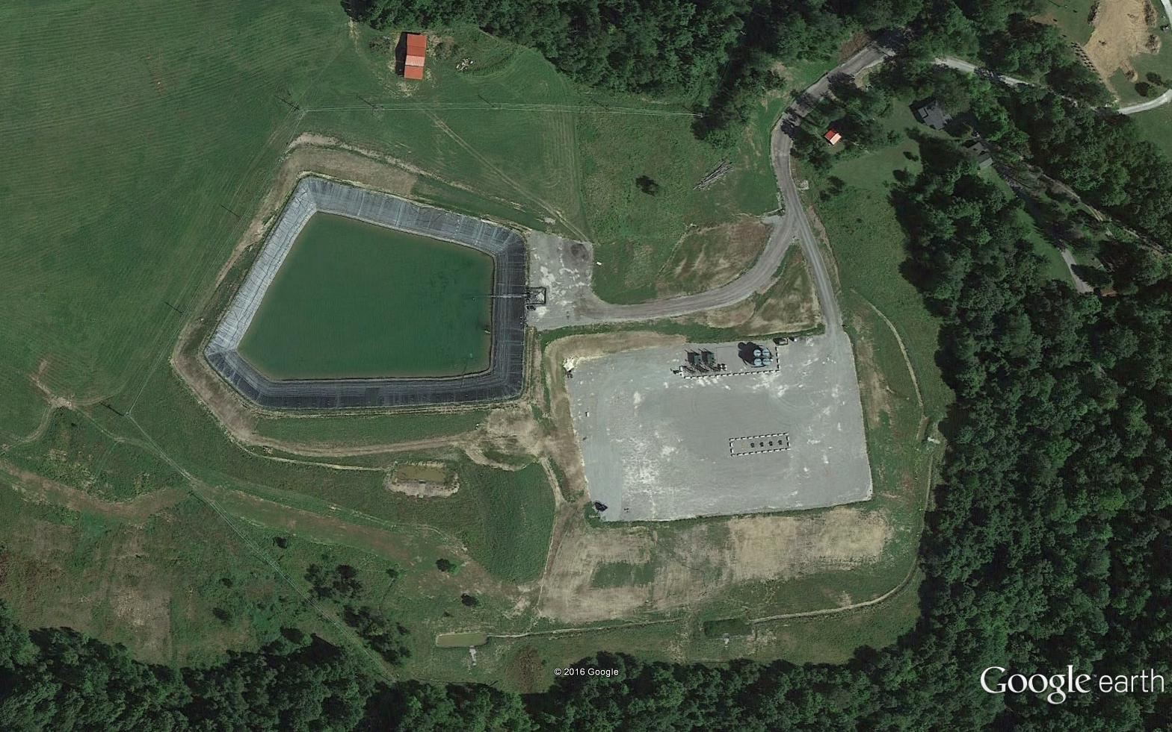
Producing well site with impoundment
6 hectares:
access/service road
well heads
separators
condensate tanks

Slide 8
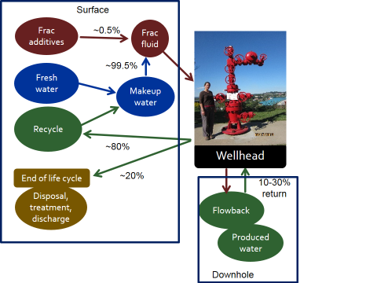
Fluids at the well site

Slide 9
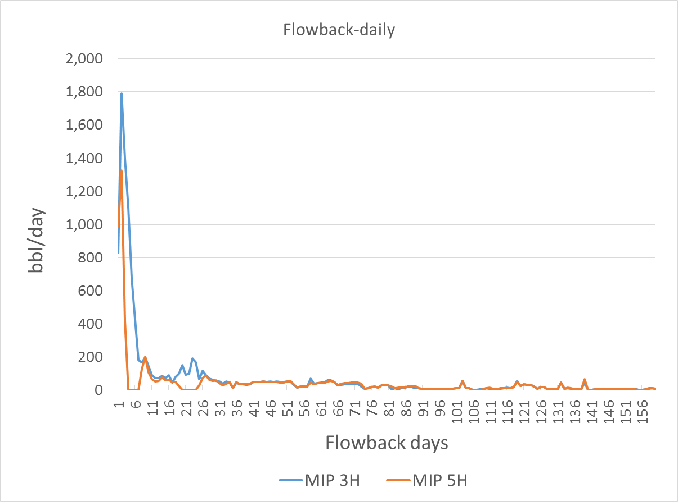
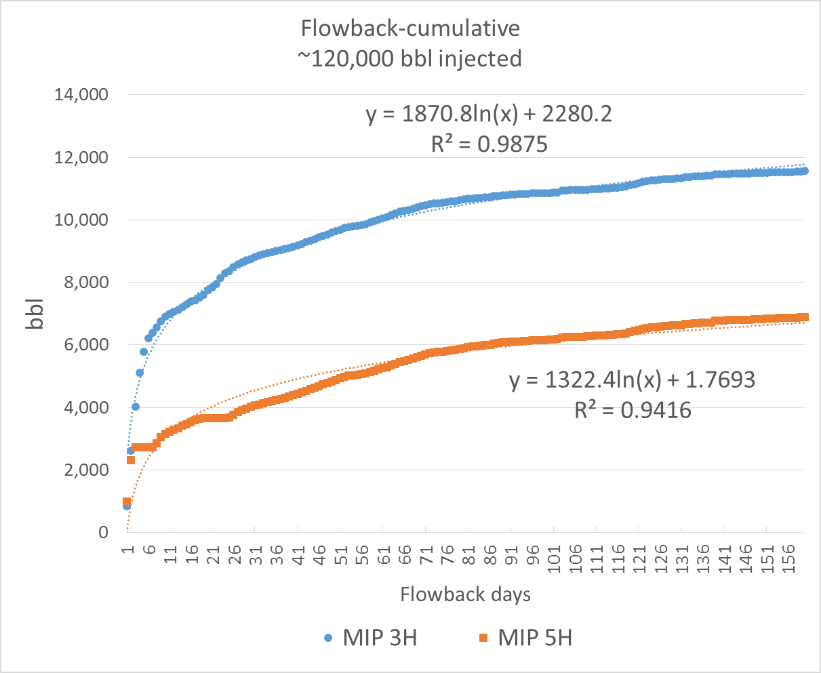
Produced water volumes: MIP 3,5H after160 days
3H produced 92% more water, 30% more gas
1 bbl=0.16 m³
6.25 bbl/m³
~10% of injected water
4675 bbl

Slide 10
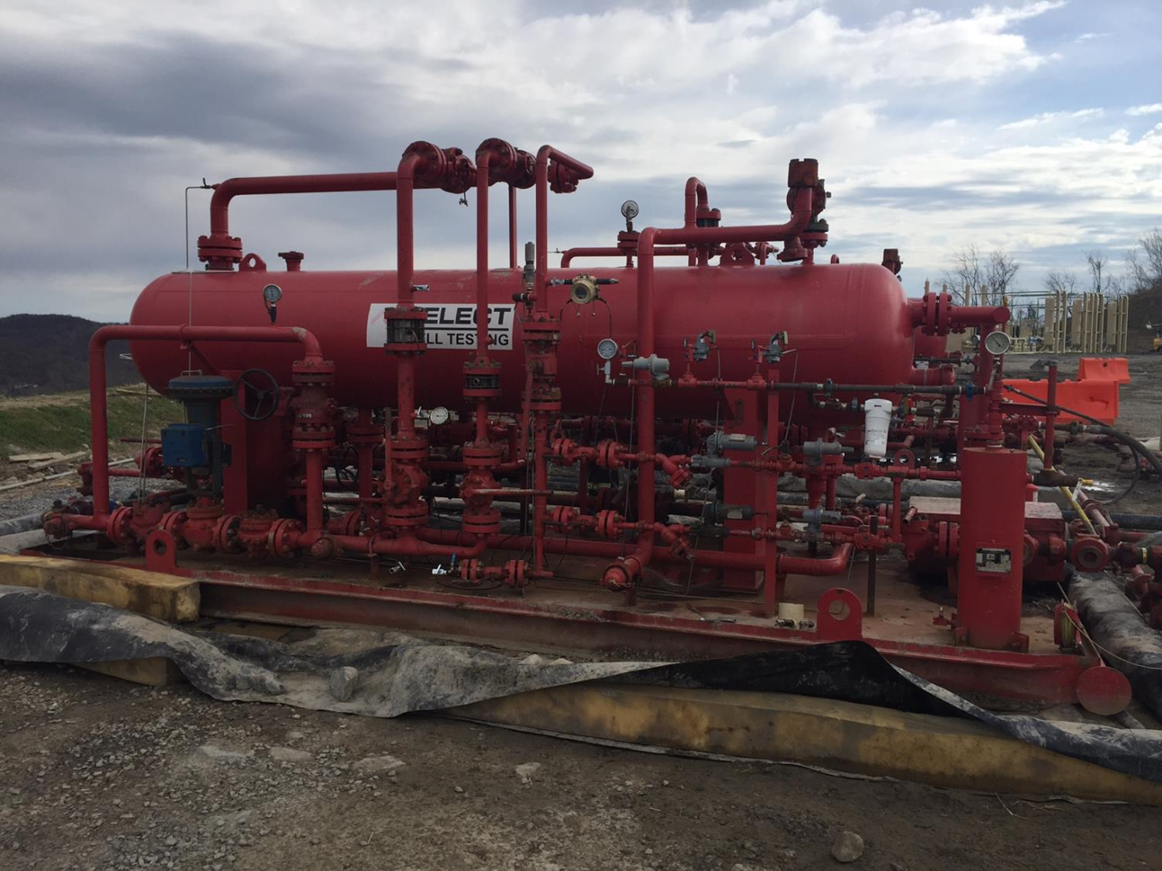
Chemical Characterization
Flowback/produced water
  Sampled at upstream end of seperators
Hydraulic fracturing fluid
Drilling mud

Slide 11
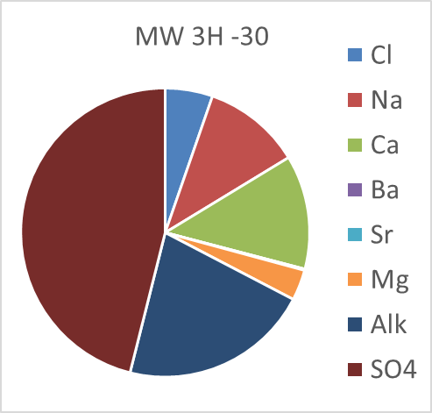
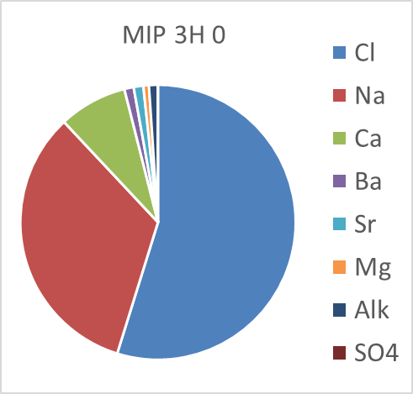
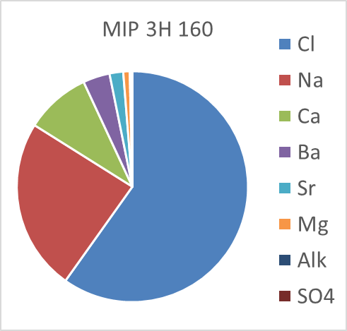
Produced water evolution: MIP 3H
Makeup-Mon River
TDS: 285 mg/L
Flowback day 0
TDS: 27,812 mg/L
Flowback day 160
TDS: 121,536 mg/L
30 days post completion

Slide 12
Nearly all parameters were higher in flowback than frac fluid
MW=makeup water
HF=frac fluid
MIP=produced water

Slide 13
MW: Makeup water, HF: Hydraulic fracturing fluid, MIP: produced water

Slide 14
Terminology: solid wastes
Drilling mud
  Returns to the surface with cuttings during drilling
  Recycled after cuttings removed
  To disposal after well completed
Drill cuttings
  Rock fragments-clay to fine gravel
  ~500-800 tons/well or 25 to 50 truckloads
  To disposal after separation from drilling mud
Flowback Solids-filter cake, precipitates, suspended solids

Slide 15
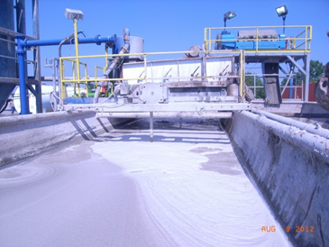
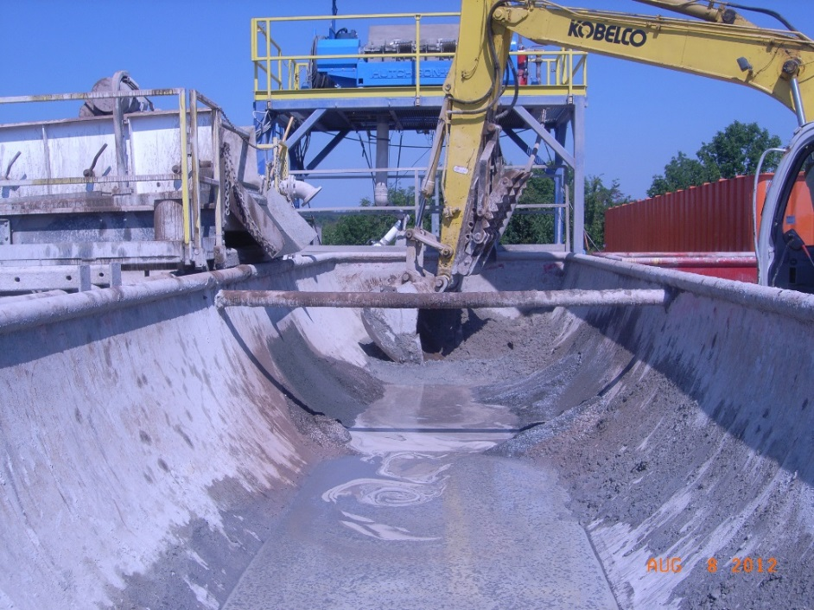
Drilling wastes
Mud
Cuttings

Slide 16
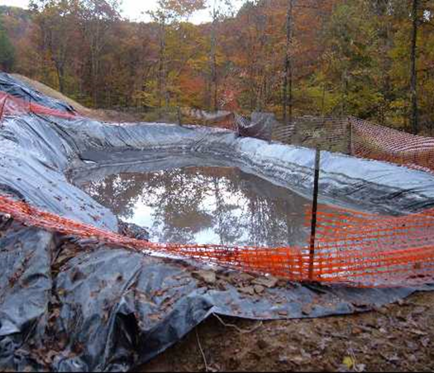
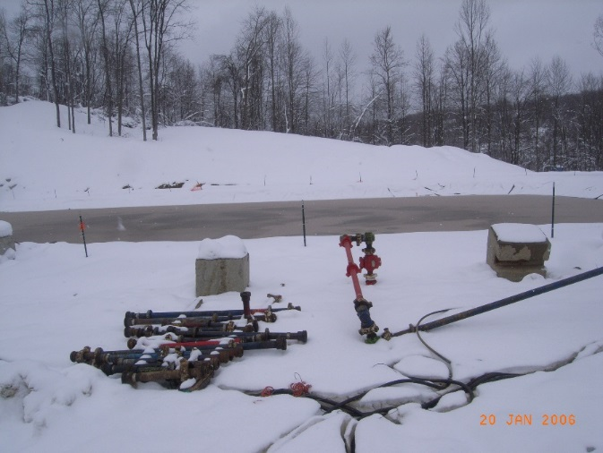
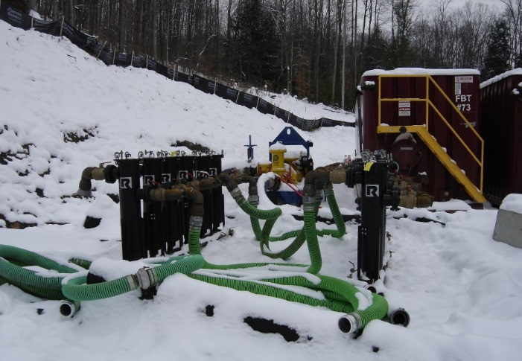
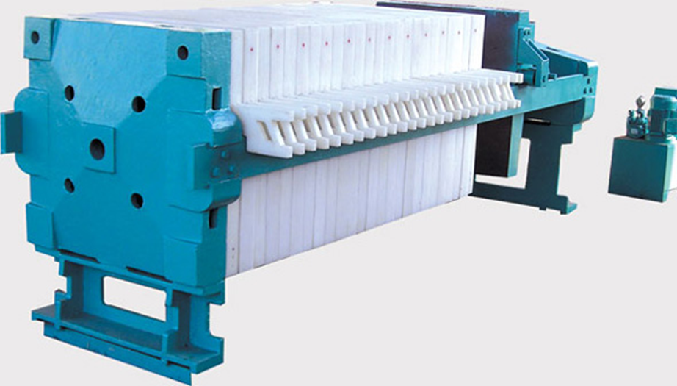
Solids separation
Flowback pit
Cuttings pit
Flowback tanks
Bag filters
Plate and frame filter press

Slide 17
Conventional drilling mud
Drill Cuttings
% samples
(Liquid fraction)
> TCLP limit

Slide 18
Using ‘Green’ Drilling Mud no parameters exceeded TCLP
In the Vertical and Horizontal (Marcellus) sections:
  TCLP organics-no exceedances
  TCLP inorganics-no exceedances

Slide 19
Drilling mud: Bio-Base^{tm} 365
Property Unit Value Test Method
Physical state Liquid Visual
Biodegradation, 28 days %m 55-60 % OECD 301
Potential carcinogenic label - No -
BTEX** mg/kg < 1 * ASTM 5790 mod.
PAH mg/kg < 0.1 * EPA 8100
*Below the detection level of the method.
**BTEX (Benzene, Ethylbenzene, Toluene, Xylene).

Slide 20
Radiochemistry: drill cuttings
USDOT low level radioactive waste: 2,000 pCi/g

Slide 21
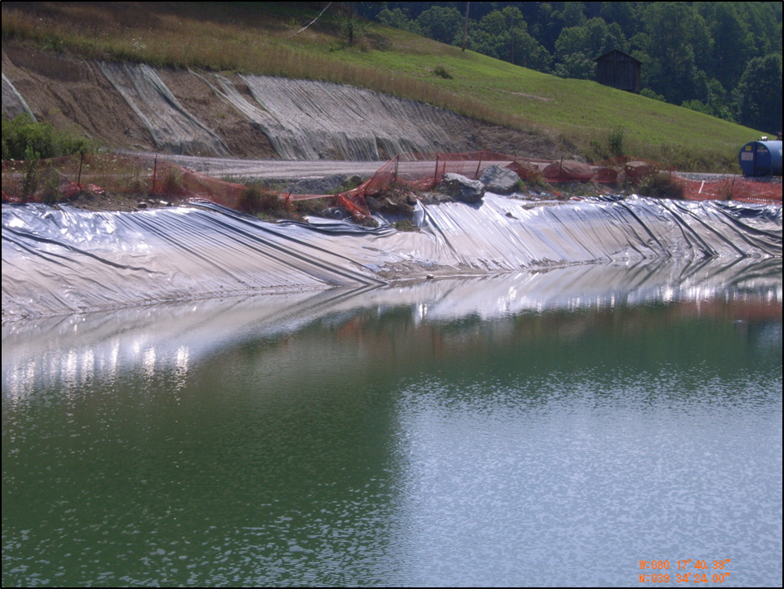
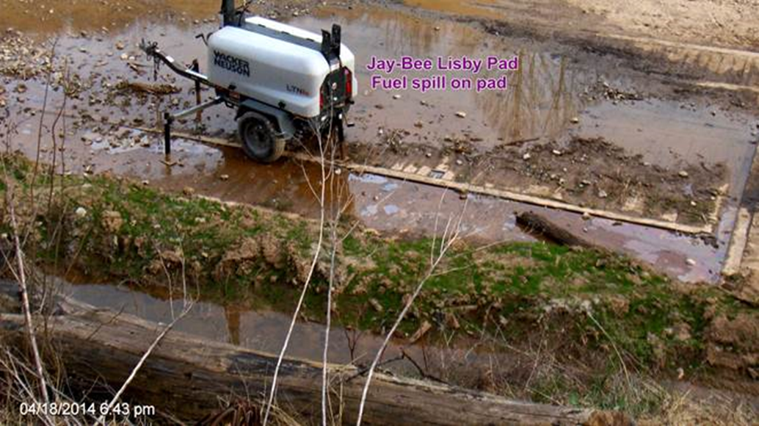
Leakage: Avoidable sources of contamination
Bank failure under liner
Fuel leak at generator
No secondary containment on drill pad

Slide 22
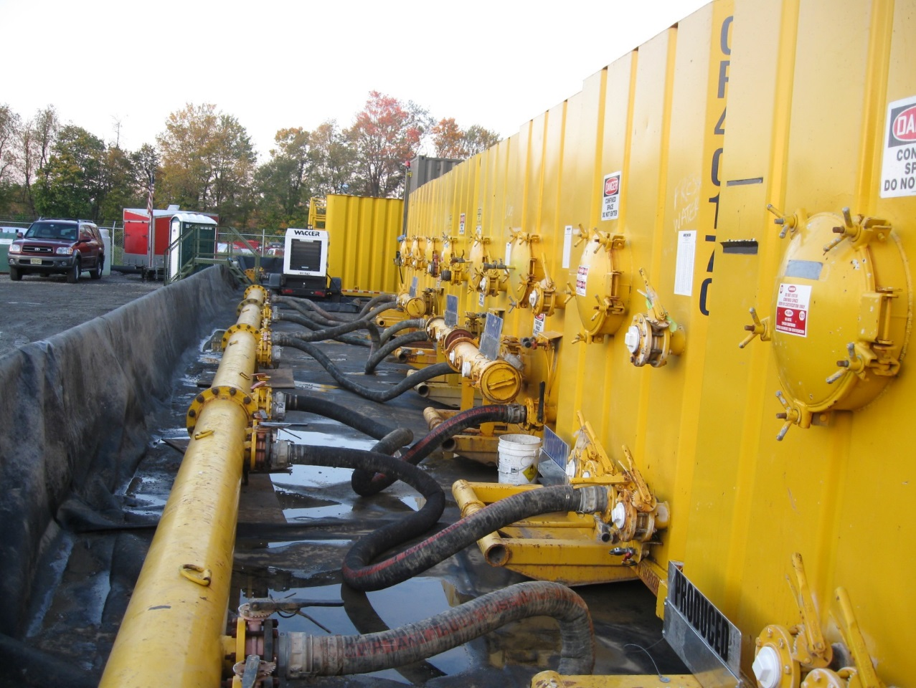
Containing leaks

Slide 23
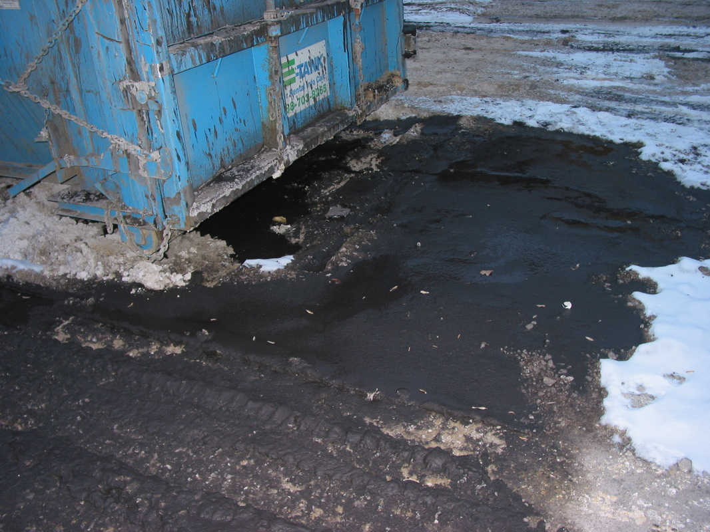
Roll-off container leaking drill cuttings and fluid onto unlined drill pad

Slide 24
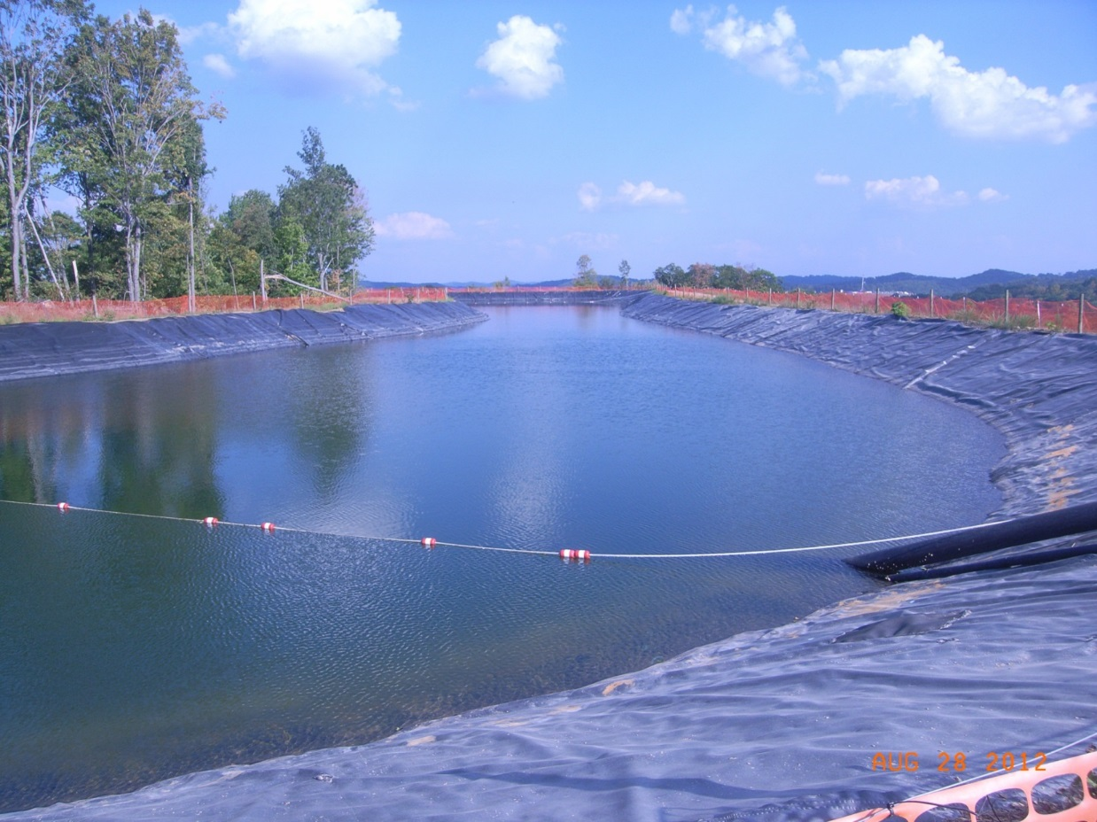
Good: A properly constructed Impoundment

Slide 25
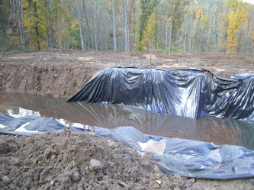
Bad: Poorly installed plastic liner

Slide 26
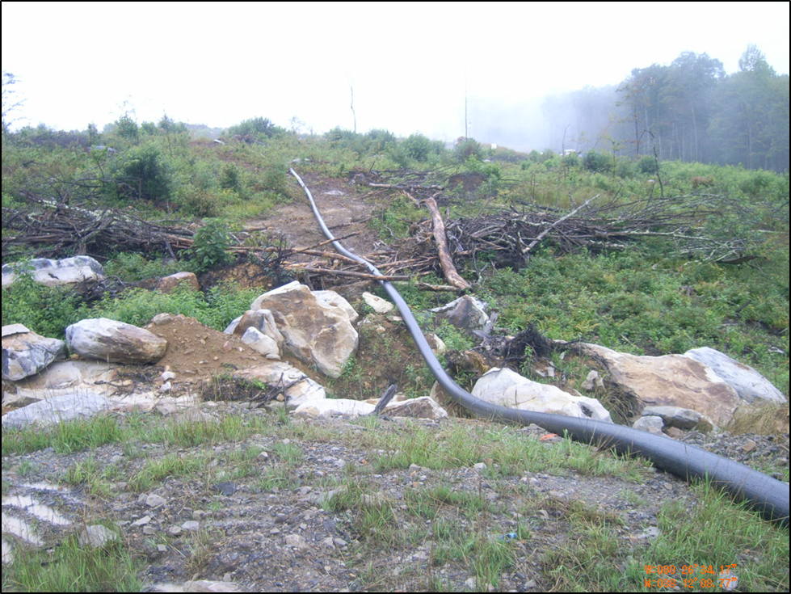
Unsupported pipe may break

Slide 27
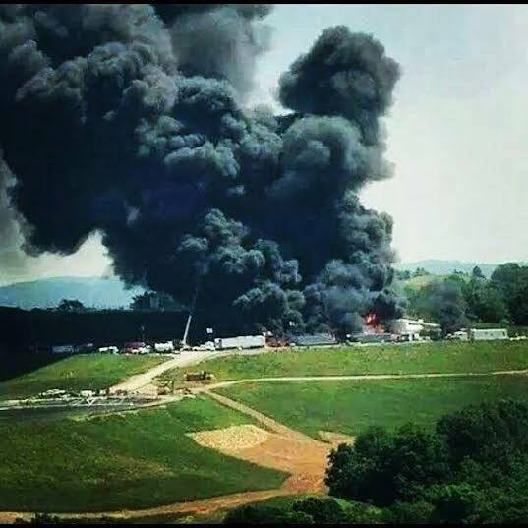
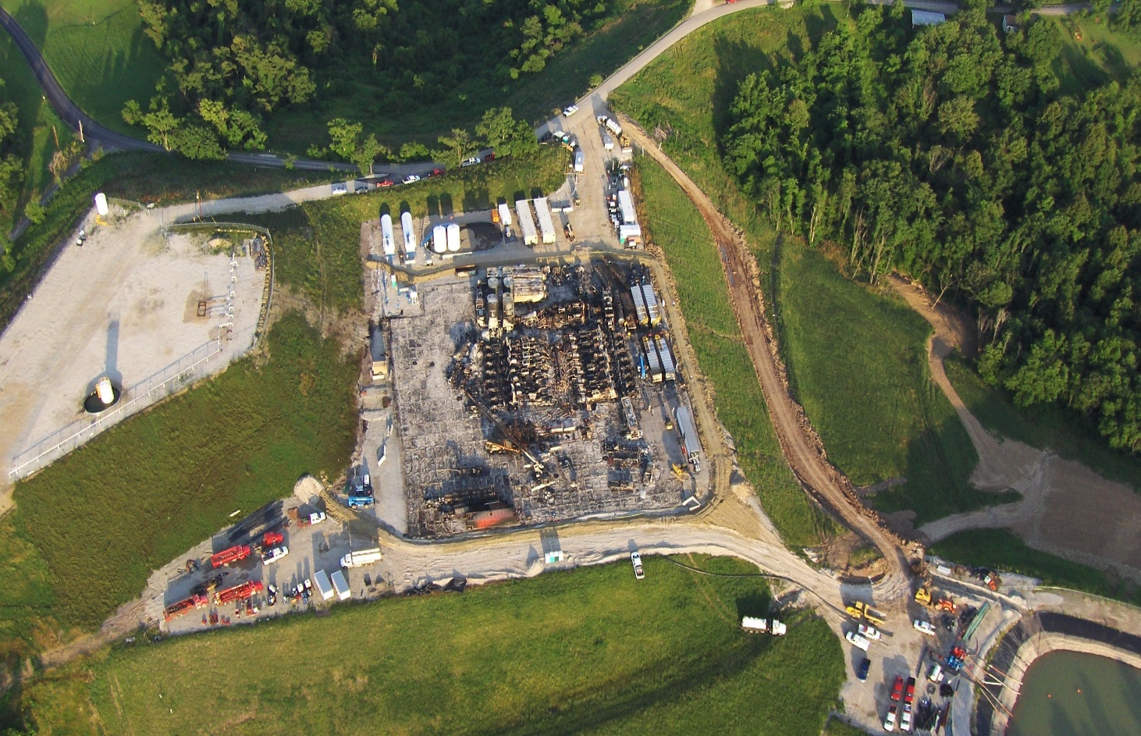
Explosions are rare but this one resulted in a major produced water release and fish kill
No secondary containment

Slide 28
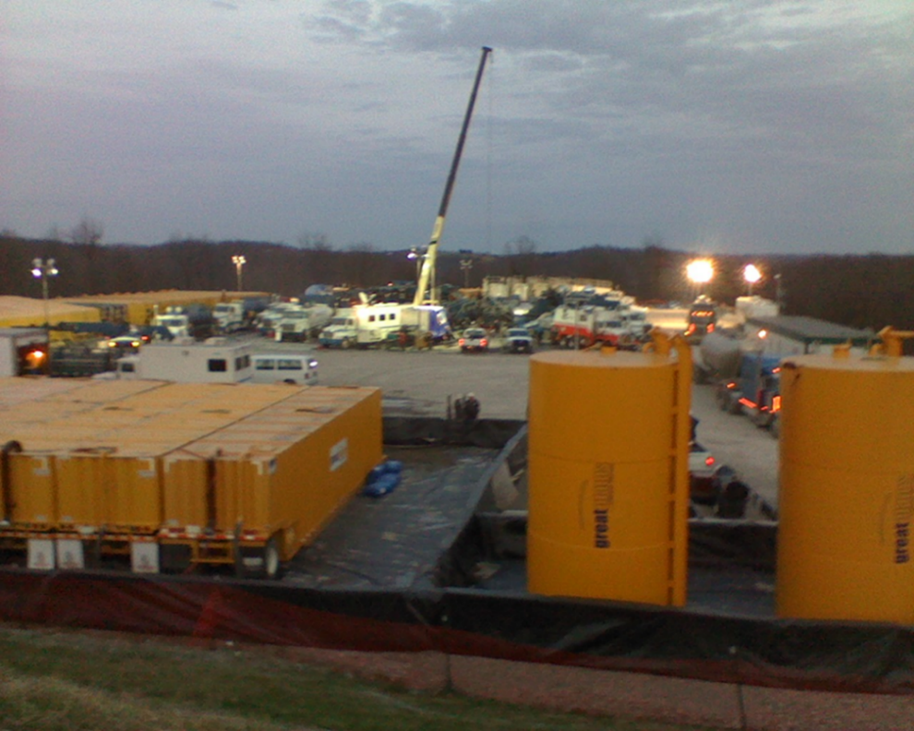
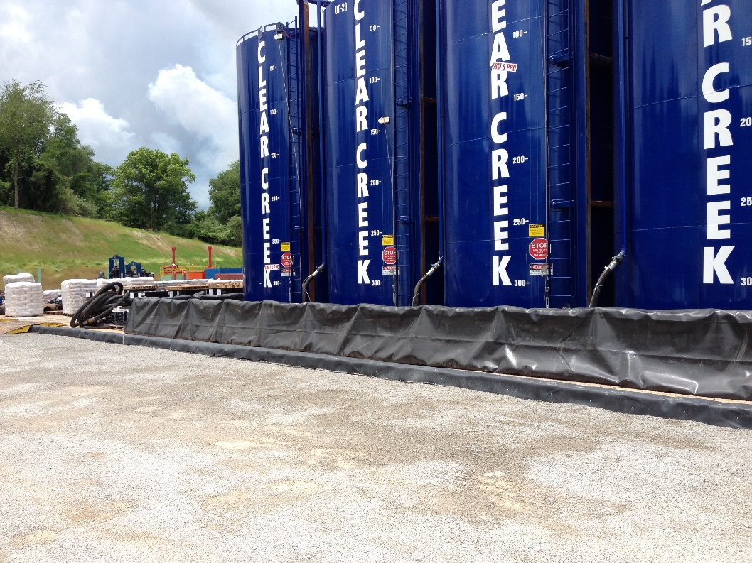
Practical Risk Reduction:
Polymer liner across drill pad covered with gravel.
Secondary Containment around tanks

Slide 29
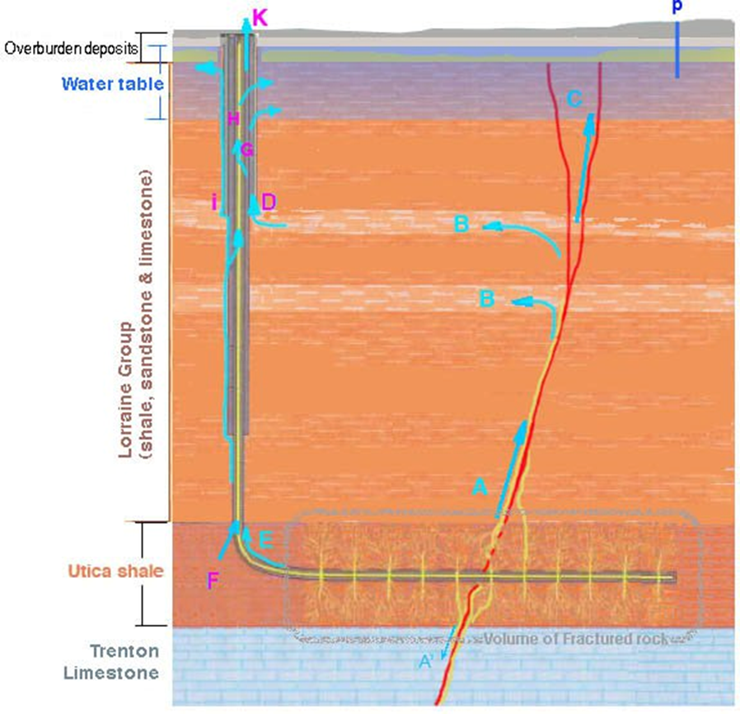
Exposure Pathways
A. Has not been documented
B. Documented, results from poor well integrity
B
maybe
A
doubtful

Slide 30
Most likely human/environmental exposure pathways
Well site spills and pit leakage
Well
Flowback pit
Domestic
well ~30 m
Spring
Shallow Aquifer
Casing/cement failure
Pit or well site leakage could appear in a
domestic well, a spring or a stream

Slide 31
Recommendations: reducing accidental releases of Produced Water
Recycle/reuse flowback and produced water for frac water makeup
On site containment:
  Production casing integrity-testing prior to well completion
  Drill pad-lined and bermed
  Pits-construction/design/inspection according to State standards
  Flowback lines to be properly installed/protected
Transportation:
  Tracking and accountability
Solid waste characterization and disposal according to protective standards (RCRA)

Slide 32
Conclusions
Produced water is highly contaminated
  Saline
  Organics (much less in dry gas wells)
  Radiochemicals
  All increase through production cycle
  Managed through recycle as makeup water
Drill cuttings toxicity controlled by drilling fluids
Exposure control via approved disposal methods
Drill cuttings radioactivity is low

Slide 33
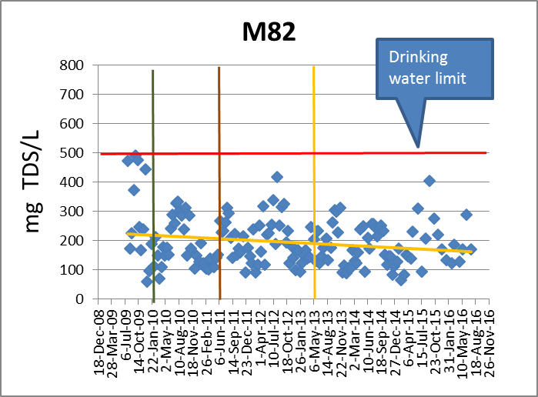
Salts have been declining in the Monongahela River since 2010

Slide 34
For more information Please Contact:
Paul Ziemkiewicz
pziemkie@wvu.edu
304 293 6958

